Slide 1
CTU-13 Botnet Classification
Neil Collins

Slide 2

Business Understanding
Bots are a major threat to cybersecurity
Distributed Denial of Service (DDOS)
Malware
Analytics Disruption
Identifying bots beforehand improves security and leads to savings
Goal: To classify bi-directional netflows that belong to malicious IP addresses
90% Accuracy
Image Courtesy: Roger A. Grimes, 2020
csoonline.com/article/2615925/security-your-quick-guide-to-malware-types.html

Slide 3
Data Understanding
13 Scenarios
20,643,076 total flows
432,755 botnet flows (2.1%)
369,806 normal flows (1.8%)
19,840,515 background flows (96.1%)
7 bots with varied IPs, protocols
15 features
Duration
Total Packets
Total Bytes
Source Bytes
Protocol
Source IP

Slide 4
Data Preparation
13 scenarios combined into one dataframe
Only Scenarios 9-12 utilized more than one bot
Blending of identifiers
Unnecessary features dropped
Target feature ‘Malicious’ encoded based on Src IP
Data Balancing
Random subset of non-malicious flows
Final malicious flows = final non-malicious flows
Final DF ~ 900,000 rows

Slide 5
Modeling - Overview
Literature Suggestions
Random Forest Classification
Gaussian Naive Bayes
XGBoost
Support Vector Machines
Per-Scenario Models
Largely useless
Unbalanced
High accuracy regardless
“Getting my feet wet”

Slide 6
Modeling - Overview
Aggregate Models
Random Forest Classifier
80/20 Split
500 max_leaf nodes
Optimal ROC AUC, Accuracy
Runtime
Grid Searching?
Naive Gaussian Bayes
Initial Results Mediocre

Slide 7
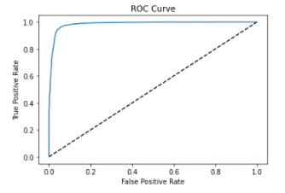
Modeling - Model Assessment
Random Forest Classifier
ROC AUC: 0.950
F1 Score: 0.949
Accuracy: 0.950
84,713 True Negatives
83,811 True Positives
5,297 False Negatives (3%)
3,574 False Positives (2%)
Gaussian Naive Bayes
ROC AUC: 0.546
F1 Score: 0.683
Accuracy: 0.547

Slide 8
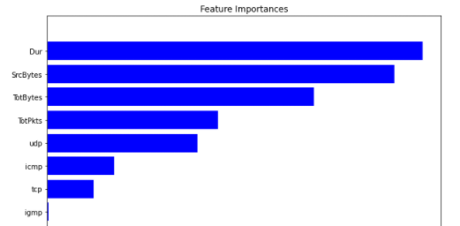
Modeling - Feature Importance
Very Basic
feature_importances_
Built-in Function
Less accurate

Slide 9
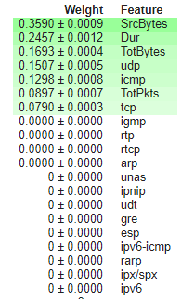
Modeling - Permutation Importance
Shuffles one feature at a time
SHAP Package
Hold all else constant
SrcBytes
Dur
TotBytes
UDP

Slide 10
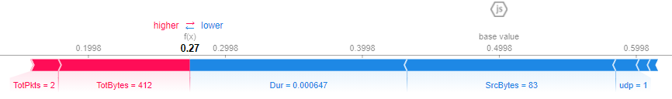
Modeling - Single Value SHAP

Slide 11
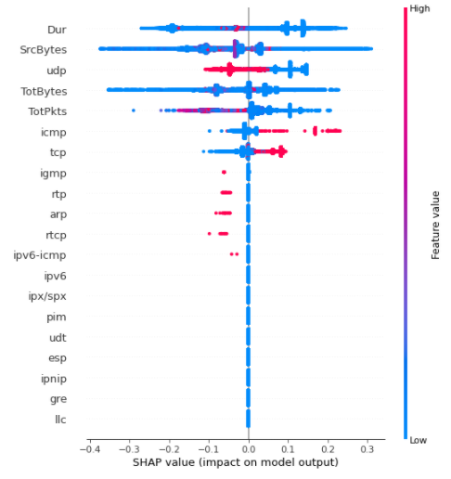
Modeling - SHAP Summary Plot
Color
High or Low for row
Horizontal
Positive or Negative impact (Magnitude)

Slide 12
Modeling - Black Box Conclusions
Most Impactful Overall Features:
Source Bytes
Duration
Total Bytes
UDP
Most likely protocol to be malicious
Total Packets

Slide 13
Evaluation
Project Goal: 90% Predictive Accuracy
95%+ across all metrics on test ✔️
Black Box Explored ✔️
Process Review:
Per Scenario Models Useless
Learning Tool
Grid Searching
Deployment Preparation (Theoretical):
Pipeline Generation (Pyspark)
Automated cleaning
Generalized for other datasets

Slide 14

Deployment (Theoretical)
Flask App Generation
Docker Containerization
Cloud Deployment

Slide 15
Acknowledgements
Dr. Eric Goodman
Dr. Dave Eargle
MSBA Cohort

Slide 16
References & Related Works
[1] García, S., Grill, M., Stiborek, J., &amp; Zunino, A. (2014, June 05). An empirical comparison of botnet detection methods. Retrieved March 27, 2021,from https://www.sciencedirect.com/science/article/pii/S0167404814000923
[2] Garcia, Sebastian. Malware Capture Facility Project. Retrieved from https://stratosphereips.org
[3] Haghighat, M. H., & Li, J. (2018, November). Edmund: Entropy based attack Detection and Mitigation engine Using Netflow Data. Retrieved February 27th, 2021 from https://www.researchgate.net/publication/329457489_Edmund_Entropy_based_attack_Detection_and_Mitigation_engine_Using_Netflow_Data.
[4] Le, D., & Zincir-Heywood, N., & Heywood, M., Data analytics on network traffic flows for botnet behaviour detection. Retrieved February 27, 2021 from https://ieeexplore.ieee.org/document/7850078
[5] Vishwakarma, A. (2020, May). Network Traffic Based Botnet Detection Using Machine learning. Retrieved March 1, 2021 from https://scholarworks.sjsu.edu/cgi/viewcontent.cgi?article=1917&context=etd_projects

